Slide 1
Inheritance
Mohammad Salman
Dean’s Fellow

Slide 2
Runtime Polymorphism
We’ll start with a concept that will set the stage for polymorphism.
https://www.learncpp.com/cpp-tutorial/pointers-and-references-to-the-base-class-of-derived-objects/

Slide 3
Note the methods. getName() is redefined in Derived.
class Base
{
protected:
int m_value {};
public:
Base(int value)
: m_value{ value }
{}
std::string getName() const
{ return "Base"; }
int getValue() const { return m_value; }
};
class Derived: public Base
{
public:
Derived(int value)
: Base{ value }
{}
std::string getName() const
{ return "Derived"; }
int getValueDoubled() const { return m_value * 2; }
};
Note
The signature and the return type don’t need to be the same. You could have had a different return type and no const,
void Derived::getName();
Having the same name causes Base::getName() to be hidden by Derived::getName().

Slide 4
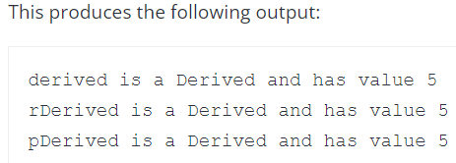
The main() function seems fine.
int main()
{
Derived derived{ 5 };
std::cout << "derived is a "
<< derived.getName()
<< " and has value "
<< derived.getValue() << '\n';
Derived& rDerived{ derived };
std::cout << "rDerived is a "
<< rDerived.getName()
<< " and has value "
<< rDerived.getValue() << '\n';
Derived* pDerived{ &derived };
std::cout << "pDerived is a "
<< pDerived->getName()
<< " and has value "
<< pDerived->getValue() << '\n';
return 0;
}
class Base
{
protected:
int m_value {};
public:
Base(int value)
: m_value{ value }
{}
std::string getName() const
{ return "Base"; }
int getValue() const { return m_value; }
};
class Derived: public Base
{
public:
Derived(int value)
: Base{ value }
{}
std::string getName() const
{ return "Derived"; }
int getValueDoubled() const { return m_value * 2; }
};
Accessing the object’s attributes directly.
Through a reference.
Through a pointer.
Notes:
Draw on the board.
The reference and pointer are referring to the same object, derived.

Slide 5
Now this is a bit weird; regardless, C++ allows this.
int main()
{
Derived derived{ 5 };
// These are both legal!
Base& rBase{ derived };
Base* pBase{ &derived };
std::cout << "derived is a "
<< derived.getName()
<< " and has value "
<< derived.getValue() << '\n';
std::cout << "rBase is a "
<< rBase.getName()
<< " and has value "
<< rBase.getValue() << '\n';
std::cout << "pBase is a "
<< pBase->getName()
<< " and has value "
<< pBase->getValue() << '\n';
return 0;
}
class Base
{
protected:
int m_value {};
public:
Base(int value)
: m_value{ value }
{}
std::string getName() const
{ return "Base"; }
int getValue() const { return m_value; }
};
class Derived: public Base
{
public:
Derived(int value)
: Base{ value }
{}
std::string getName() const
{ return "Derived"; }
int getValueDoubled() const { return m_value * 2; }
};
Through a Base reference.
Through a Base pointer.

Slide 6
Recall that child objects are composed of multiple parts.
It has one part for each inherited class, and a part for itself.
So a pointer or a reference of a parent type can be used to point or refer to a child type object.
However, there is a catch with this.
Because rBase and pBase are of Base type, they can only see members of Base (or any classes that Base inherited).
But they cannot see members in Derived.
int main()
{
Derived derived{ 5 };
// These are both legal!
Base& rBase{ derived };
Base* pBase{ &derived };
std::cout << "derived is a "
<< derived.getName()
<< " and has value "
<< derived.getValue() << '\n';
std::cout << "rBase is a "
<< rBase.getName()
<< " and has value "
<< rBase.getValue() << '\n';
std::cout << "pBase is a "
<< pBase->getName()
<< " and has value "
<< pBase->getValue() << '\n';
return 0;
}
Through a Base reference.
Through a Base pointer.

Slide 7
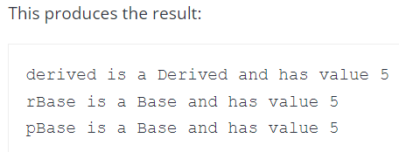
Note the outputs.
rBase and pBase are a Base reference and pointer, they can only see members of Base (or any classes that Base inherited).
int main()
{
Derived derived{ 5 };
// These are both legal!
Base& rBase{ derived };
Base* pBase{ &derived };
std::cout << "derived is a "
<< derived.getName()
<< " and has value "
<< derived.getValue() << '\n';
std::cout << "rBase is a "
<< rBase.getName()
<< " and has value "
<< rBase.getValue() << '\n';
std::cout << "pBase is a "
<< pBase->getName()
<< " and has value "
<< pBase->getValue() << '\n';
return 0;
}
Through a Base reference.
Through a Base pointer.

Slide 8
Could you do pBase->getValueDoubled();
int main()
{
Derived derived{ 5 };
// These are both legal!
Base& rBase{ derived };
Base* pBase{ &derived };
std::cout << "derived is a "
<< derived.getName()
<< " and has value "
<< derived.getValue() << '\n';
std::cout << "rBase is a "
<< rBase.getName()
<< " and has value "
<< rBase.getValue() << '\n';
std::cout << "pBase is a "
<< pBase->getName()
<< " and has value "
<< pBase->getValue() << '\n';
return 0;
}
Nope, rBase and pBase can’t see members in Derived.
class Base
{
protected:
int m_value {};
public:
Base(int value)
: m_value{ value }
{}
std::string getName() const
{ return "Base"; }
int getValue() const { return m_value; }
};
class Derived: public Base
{
public:
Derived(int value)
: Base{ value }
{}
std::string getName() const
{ return "Derived"; }
int getValueDoubled() const { return m_value * 2; }
};
Through a Base reference.
Through a Base pointer.

Slide 9
Could you create an array that has Base and Derived objects?
int main()
{
Derived derived{ 5 };
// These are both legal!
Base& rBase{ derived };
Base* pBase{ &derived };
std::cout << "derived is a "
<< derived.getName()
<< " and has value "
<< derived.getValue() << '\n';
std::cout << "rBase is a "
<< rBase.getName()
<< " and has value "
<< rBase.getValue() << '\n';
std::cout << "pBase is a "
<< pBase->getName()
<< " and has value "
<< pBase->getValue() << '\n';
return 0;
}
class Base
{
protected:
int m_value {};
public:
Base(int value)
: m_value{ value }
{}
std::string getName() const
{ return "Base"; }
int getValue() const { return m_value; }
};
class Derived: public Base
{
public:
Derived(int value)
: Base{ value }
{}
std::string getName() const
{ return "Derived"; }
int getValueDoubled() const { return m_value * 2; }
};
Through a Base reference.
Through a Base pointer.

Slide 10
We need a data type that can manage both types of objects – Base and Derived in our example.
We saw that parent type pointers can point to both parent objects (obviously), and also child objects with the limitation that the object’s own members (in the child class) can’t be accessed through the parent type pointer (based on what we’ve seen thus far).
Therefore, we can do the following.
int main()
{
Derived d1{ 10 };
Derived d2{ 20 };
Base b1{ 100 };
Base b2{ 200 };
Derived d3{ 30 };
Base* bPtrs[]{ &d1, &d2, &b1, &b2, &d3 };
return 0;
}

Slide 11
int main()
{
Derived d1{ 10 };
Derived d2{ 20 };
Base b1{ 100 };
Base b2{ 200 };
Derived d3{ 30 };
Base* bPtrs[]{ &d1, &d2, &b1, &b2, &d3 };
return 0;
}
This is a big benefit of having parent type pointers being able to point at child objects.
Do note, however, that through these Base*, we have sacrificed the accessibility of Derived type objects.
0 | 1 | 2 | 3 | 4
&d1 | &d2 | &b1 | &b2 | &d3
Derived d1
&d1
Derived d2
&d2
Base b1
&b1
Base b2
&b2
Derived d3
&d3

Slide 12
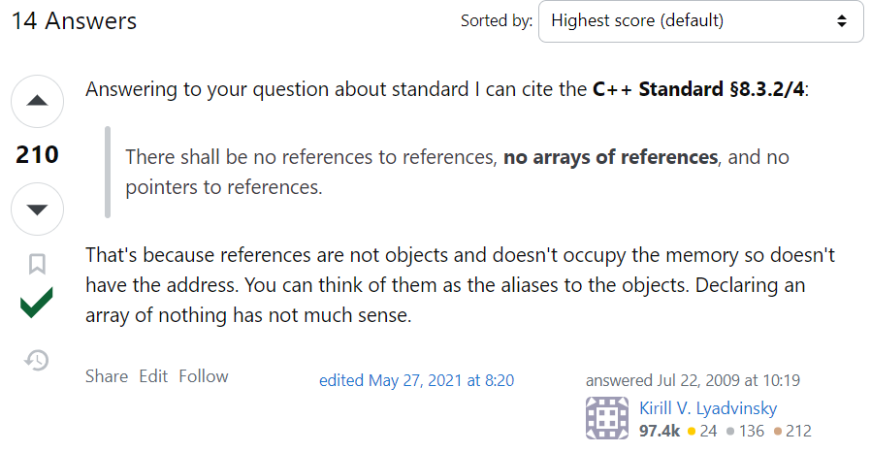
Based on a question asked in class.
You cannot create an array of references. In our example, therefore we would need an array of Base* so that we can hold pointers to Base and Derived objects (in the last example).
References are as follows.
https://www.learncpp.com/cpp-tutorial/arrays-of-references-via-stdreference_wrapper/
https://stackoverflow.com/questions/1164266/why-are-arrays-of-references-illegal
Think of objects as any entity or variable in this context.

Slide 13
Another big benefit of this capability is that we can avoid writing overloaded functions for each derived class.
Let’s say I have the following function (not a member of any class, but is a normal function in the global scope).
The Base and Derived classes are defined as shown earlier.
void whoAmI(const Base& obj)
{
std::cout << "I am " << obj.getName()
<< “ with value = " << obj.getValue()
<< '\n’;
}
int main()
{
Base b1{ 100 };
Derived d1{ 10 };
b1.whoAmI();
return 0;
}
(Ungraded) Quiz
What is the output of this program?
Base, 100
Base, 10
Derived, 100
Derived, 10
Compiler error
Notes:
Compiler error – b1.whoAmI() doesn’t work because the function is not part of the class.

Slide 14

This would be the output.
void whoAmI(const Base& obj)
{
std::cout << "I am " << obj.getName()
<< “ with value = " << obj.getValue()
<< '\n’;
}
int main()
{
Base b1{ 100 };
Derived d1{ 10 };
whoAmI(b1);
return 0;
}

Slide 15

This will work with d1 as well because parent references can be aliases for child objects.
The problem is the same here that the Base& cannot see Derived’s own members, therefore, it is utilizing Base’s implementation of getName().
In case of getValue(), again Base’s implementation is being used, but that is how we want it to be.
void whoAmI(const Base& obj)
{
std::cout << "I am " << obj.getName()
<< “ with value = " << obj.getValue()
<< '\n’;
}
int main()
{
Base b1{ 100 };
Derived d1{ 10 };
// whoAmI(b1);
whoAmI(d1);
return 0;
}
As mentioned earlier, the benefit here is that you don’t need to write separate overloads for the two classes.
In the future, if there are more derived classes, this single function would suffice.

Slide 16
Virtual Functions
These help in achieving (runtime) polymorphism.
https://www.learncpp.com/cpp-tutorial/virtual-functions/

Slide 17
Virtual Functions
The sacrifice we made: The parent type pointer cannot see the child’s members.
Marking our member functions virtual will change this behavior.

Slide 18
Adding virtual here changes the flow of the program. Because obj is a Base&, obj.getName() would have normally resolved to Base::getName().
However, Base::getName() is marked virtual, therefore, the compiler goes to the most-derived implementation of getName().
class Base
{
protected:
int m_value {};
public:
Base(int value)
: m_value{ value }
{}
virtual std::string getName() const
{ return "Base"; }
int getValue() const { return m_value; }
};
class Derived: public Base
{
public:
Derived(int value)
: Base{ value }
{}
std::string getName() const override
{ return "Derived"; }
int getValueDoubled() const { return m_value * 2; }
};
void whoAmI(const Base& obj)
{
std::cout << "I am " << obj.getName()
<< " with value = " << obj.getValue()
<< '\n';
}
int main()
{
Base b1{ 100 };
Derived d1{ 10 };
whoAmI(d1);
return 0;
}

Slide 19
Virtual Functions
The sacrifice we made: The parent type pointer cannot see the child’s members.
Marking our member functions virtual will change this behavior.
A virtual function when called, resolves to the most-derived version of the function for the actual type of the object being referenced or pointed to.

Slide 20
This would have resolved to Base::getName() because obj is Base&.
class Base
{
protected:
int m_value {};
public:
Base(int value)
: m_value{ value }
{}
virtual std::string getName() const
{ return "Base"; }
int getValue() const { return m_value; }
};
class Derived: public Base
{
public:
Derived(int value)
: Base{ value }
{}
std::string getName() const override
{ return "Derived"; }
int getValueDoubled() const { return m_value * 2; }
};
void whoAmI(const Base& obj)
{
std::cout << "I am " << obj.getName()
<< " with value = " << obj.getValue()
<< '\n';
}
int main()
{
Base b1{ 100 };
Derived d1{ 10 };
whoAmI(d1);
return 0;
}

Slide 21
Because it’s marked virtual, the compiler will go to the most derived implementation (with respect to the object being referenced by obj) of this method.
Note that Derived::getName() is overriding Base::getName() in this situation. Compiler is using the derived version instead of the base version.
class Base
{
protected:
int m_value {};
public:
Base(int value)
: m_value{ value }
{}
virtual std::string getName() const
{ return "Base"; }
int getValue() const { return m_value; }
};
class Derived: public Base
{
public:
Derived(int value)
: Base{ value }
{}
std::string getName() const override
{ return "Derived"; }
int getValueDoubled() const { return m_value * 2; }
};
void whoAmI(const Base& obj)
{
std::cout << "I am " << obj.getName()
<< " with value = " << obj.getValue()
<< '\n';
}
int main()
{
Base b1{ 100 };
Derived d1{ 10 };
whoAmI(d1);
return 0;
}

Slide 22
Note that Base::getValue() is not marked virtual, because there is no need for it. Even for objects of class Derived, I want this (inherited) method to be executed.
class Base
{
protected:
int m_value {};
public:
Base(int value)
: m_value{ value }
{}
virtual std::string getName() const
{ return "Base"; }
int getValue() const { return m_value; }
};
class Derived: public Base
{
public:
Derived(int value)
: Base{ value }
{}
std::string getName() const override
{ return "Derived"; }
int getValueDoubled() const { return m_value * 2; }
};
void whoAmI(const Base& obj)
{
std::cout << "I am " << obj.getName()
<< " with value = " << obj.getValue()
<< '\n';
}
int main()
{
Base b1{ 100 };
Derived d1{ 10 };
whoAmI(d1);
return 0;
}

Slide 23
Virtual Functions
The sacrifice we made: The parent type pointer cannot see the child’s members.
Marking our member functions virtual will change this behavior.
A virtual function when called, resolves to the most-derived version of the function for the actual type of the object being referenced or pointed to.
A derived function is considered a match if it has the same signature (name, parameter types, and whether it is const) and return type as the base version of the function.
Such functions are called overrides.
Recommended to write “override” for overrides.

Slide 24
Note that the overriding method should have the same,
Signature (i.e., name, parameter types, and whether it is const), and,
Return type,
as the base version of the function
Note that even though you haven’t written virtual with Derived::getName(), it is implicitly assumed to be virtual.
class Base
{
protected:
int m_value {};
public:
Base(int value)
: m_value{ value }
{}
virtual std::string getName() const
{ return "Base"; }
int getValue() const { return m_value; }
};
class Derived: public Base
{
public:
Derived(int value)
: Base{ value }
{}
std::string getName() const override
{ return "Derived"; }
int getValueDoubled() const { return m_value * 2; }
};
void whoAmI(const Base& obj)
{
std::cout << "I am " << obj.getName()
<< " with value = " << obj.getValue()
<< '\n';
}
int main()
{
Base b1{ 100 };
Derived d1{ 10 };
whoAmI(d1);
return 0;
}

Slide 25
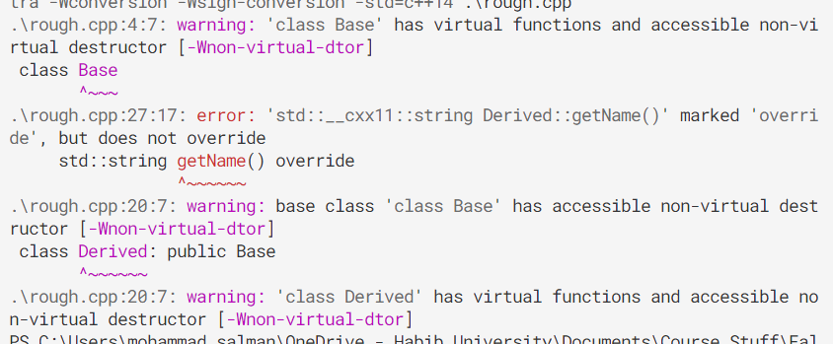
This override is optional. However, it is highly recommended to use.
You may recall from your lab how you were encountering mistakes. Using override would have alerted you.
e.g. This is the error you were getting (I have forgotten to add const here).
The warnings are relevant to a future topic – virtual destructors.
class Base
{
protected:
int m_value {};
public:
Base(int value)
: m_value{ value }
{}
virtual std::string getName() const
{ return "Base"; }
int getValue() const { return m_value; }
};
class Derived: public Base
{
public:
Derived(int value)
: Base{ value }
{}
std::string getName() const override
{ return "Derived"; }
int getValueDoubled() const { return m_value * 2; }
};

Slide 26
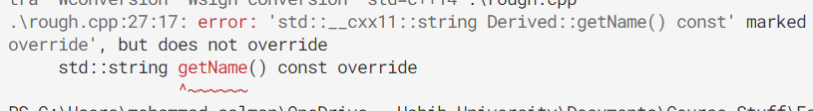
This is another error that override helps you with (I haven’t marked the base method as virtual).
class Base
{
protected:
int m_value {};
public:
Base(int value)
: m_value{ value }
{}
virtual std::string getName() const
{ return "Base"; }
int getValue() const { return m_value; }
};
class Derived: public Base
{
public:
Derived(int value)
: Base{ value }
{}
std::string getName() const override
{ return "Derived"; }
int getValueDoubled() const { return m_value * 2; }
};

Slide 27
More examples to help you understand the ways override could help you with…
Check the file override.cpp
It has notes within comments to help you understand the problems.

Slide 28
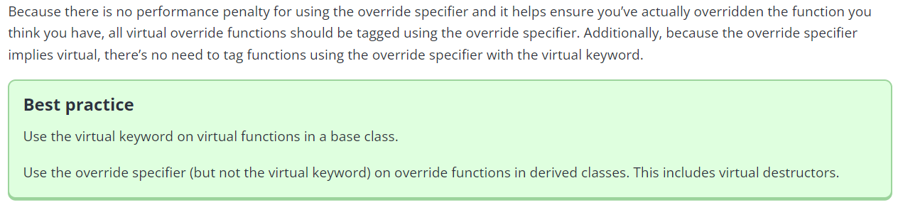
override
https://www.learncpp.com/cpp-tutorial/the-override-and-final-specifiers-and-covariant-return-types/

Slide 29
What will be the output of this program?
ptrA is a C
class A
{
public:
virtual std::string getName() const { return "A"; }
};
class B: public A
{
public:
std::string getName() const override { return "B"; }
};
class C: public B
{
public:
std::string getName() const override { return "C"; }
};
class D: public C
{
public:
std::string getName() const override { return "D"; }
};
int main()
{
C c {};
A* ptrA{ &c };
std::cout << "ptrA is a " << ptrA->getName();
return 0;
}
C c {};
A
B
C
most-derived match for getName() between A and C
Note that the overriding methods in the derived classes are implicitly virtual.

Slide 30
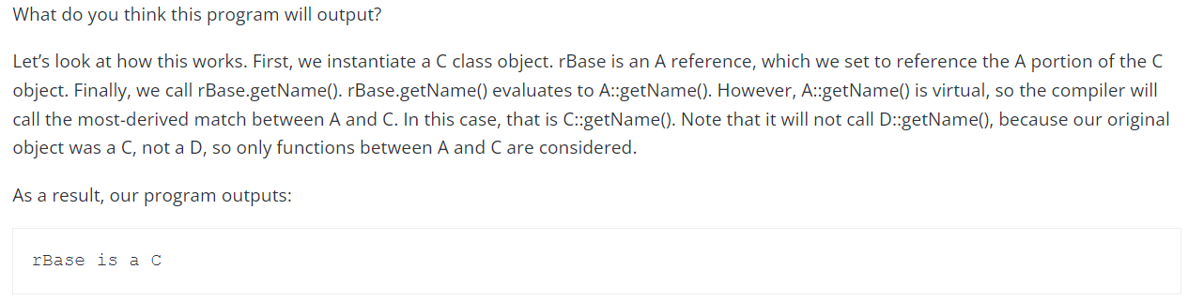
Explanation about the same-ish example from learncpp

Slide 31
What will be the output of this program?
ptrB is a C
class A
{
public:
virtual std::string getName() const { return "A"; }
};
class B: public A
{
public:
std::string getName() const override { return "B"; }
};
class C: public B
{
public:
std::string getName() const override { return "C"; }
};
class D: public C
{
public:
std::string getName() const override { return "D"; }
};
int main()
{
C c {};
B* ptrB{ &c };
std::cout << "ptrB is a " << ptrB->getName();
return 0;
}
Is this virtual?
C c {};
A
B
C
Note that the overriding methods in the derived classes are implicitly virtual.

Slide 32
Runtime Polymorphism
Question
Have we seen something similar to this earlier in the course?
What we have seen is polymorphism (that happens during runtime).
In programming, polymorphism refers to the ability of an entity to have multiple forms.
“Polymorphism” literally means “many forms”.
In our example, getName() is taking multiple forms…
… depending on the virtual function resolution.
This resolution happens during runtime (while the executable is running).

Slide 33

Runtime Polymorphism
We saw function overloading, which is an example of compile-time polymorphism.
Compile-time implies the time when you are compiling the code and in the process of creating your executable file.
Function overload resolution is done during compile-time.
Template resolution is another example of compile-time polymorphism.

Slide 34
Another example to see if you understand things…
Self-study the class Animal example under section, “A more complex example”.
Link: https://www.learncpp.com/cpp-tutorial/virtual-functions/
You can assume std::string_view to be std::string to keep things simple to understand.

Slide 35
Virtual Destructors
https://www.learncpp.com/cpp-tutorial/virtual-destructors-virtual-assignment-and-overriding-virtualization/

Slide 36
Destruction of Child Objects
A child/derived object is composed of multiple parts.
It has one part corresponding to each of its parent.
And it has one part that is its own.
For child objects to be destructed correctly, all relevant destructors should be called.
Recall the order of destruction.
Based on the above, review the code file discussed in class.
virtualDtors.cpp
On the following slides, you’ll find another example to explain virtual destructors.

Slide 37
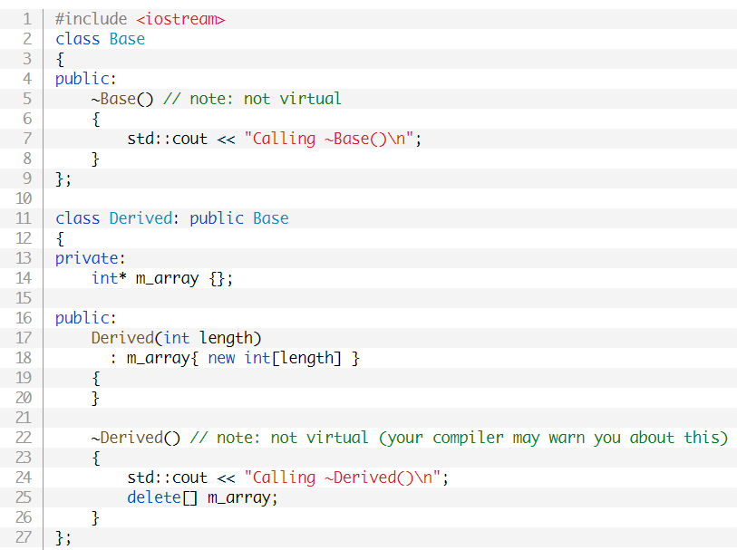
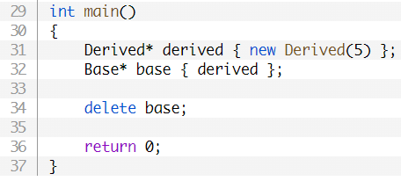
Since I’m dealing with dynamic memory, I decided to make my own Derived::~Derived().
Questions
For line 31, could I have done this:
Base* base{ new Derived(5) };
What happens when line 31 is executed?
What happens if I had skipped line 34?
Memory leak (against line 31).
Notes:
For the second question, I’m interested in knowing the ctor calls. Goes to Derived(), but then goes to Base(), then comes back, and allocates memory.

Slide 38

What happens when I do, delete base; ?
Whose dtor should be called?
base is a Base*.
So Base::~Base() would be called.
Note that once it has executed, Derived::~Derived() doesn’t get called.
Not only has memory leaked, but the object also didn’t destruct properly.

Slide 39
What happens when I do, delete base; ?
We actually want Derived::~Derived() to be called first, and after finishing execution, this will automatically call Base::~Base().
This is where virtual destructors come in.
Whose dtor should be called?
base is a Base*.
So Base::~Base() would be called.
Note that once it has executed, Derived::~Derived() doesn’t get called.
Not only has memory leaked, but the object also didn’t destruct properly.

Slide 40
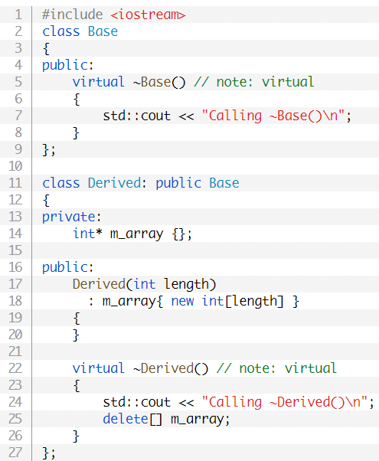
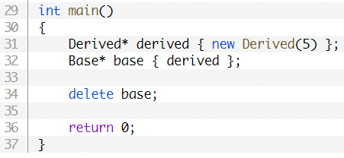
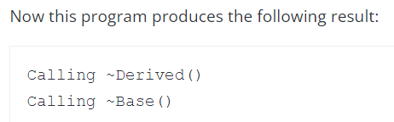
Note the modifications to the dtors.
Note that virtual on line 22 is optional.
The call would have resolved to Base::~Base(), but because it’s virtual, the compiler goes to the most derived’s destructor (wrt to the object being pointed to by base), which is Derived::~Derived().
Once ~Derived() is complete, it then automatically calls ~Base() as usual.

Slide 41
Virtual Destructors
When dealing with inheritance, always make your destructors virtual.
Even though the destructors in the child classes would be implicitly considered virtual, it can be a good idea to add virtual for the sake of readability.

Slide 42
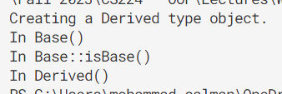
Don’t call virtual methods from within ctors and dtors.
What is the output of this program?
class Derived: public Base
{
public:
Derived() : Base{}
{
std::cout << "In Derived()\n";
}
bool isBase() const override
{
std::cout << "In Derived::isBase()\n";
return false;
}
};
class Base
{
private:
int m_num;
public:
Base() : m_num{ 0 }
{
std::cout << "In Base()\n";
this->isBase();
}
virtual bool isBase() const
{
std::cout << "In Base::isBase()\n";
return true;
} };
Any problems with main()?
int main()
{
std::cout << "Creating a Derived type object.\n";
Base* pBase{ new Derived };
return 0;
}
Notes:
Problem in main(): I’m not deallocating memory.

